Slide 1
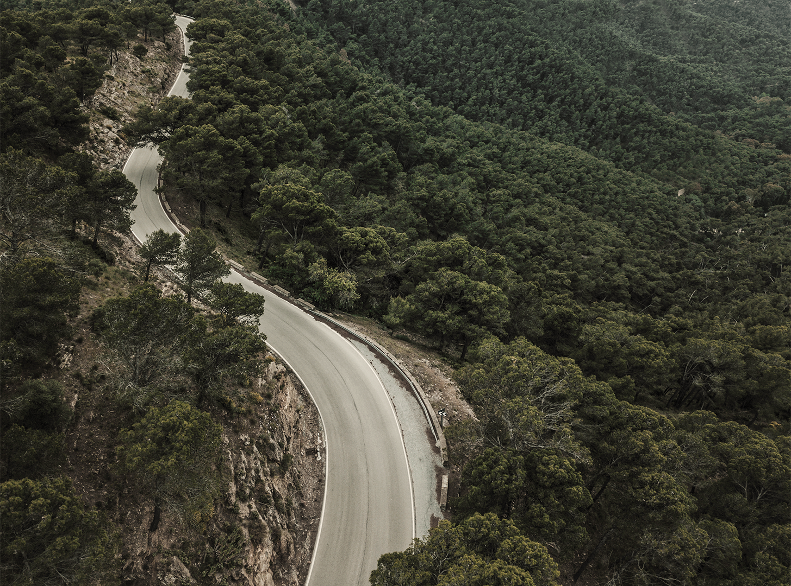
ASR DATA COLLECTION
Vaibhav Agarwal & Urvish Pujara
Under Prof. Anil Kumar Vupalla
& TA Kowshik Motepalli

Slide 2
INTRODUCTION
01
OBJECTIVES
02
TABLE OF CONTENTS
METHODS
03
DATA COLLECTION
04
FUTURE WORK
05
CHALLENGES & RESULT
06

Slide 3

INTRODUCTION
01

Slide 4

INTRODUCTION
With the complexity of the healthcare domain, specialized ASRs are required to achieve high accuracy rates.
By collecting and analyzing large amounts of domain-specific data, we can fine-tune our ASRs to better understand the nuances of the health domain.

Slide 5
OBJECTIVES
02

Slide 6
Our project was about automatic or semi-automatic data collection for ASR.
We aim to collect about five thousand hours of data per team member in the health domain, which will assist in developing domain-adapted ASR.
OBJECTIVES
We plan to collect domain data in English using our ASRs, data collection platforms and other methods like text scraping, open-source videos etc.
The data is then converted to human-speaking text.

Slide 7
METHODS
03

Slide 8
Web scraper
Curated list of websites
METHODOLOGY
Text processing
Quality control
We will developed a web scraper using Python modules like Beautiful Soup to extract textual data from the curated list of websites. The web scraper will be designed to navigate through the website, locate relevant pages, and extract the required text.
We created a list of websites relevant to the medicine domain. This list will be based on our research and understanding of the domain.
Once the textual data is collected, we processed it using Python's libraries like num2words and spellchecker. This processing will include tasks such as symbol to word conversion, spell checking, and punctuation removal, to prepare the data for further analysis.
We implemented quality control measures to ensure the accuracy and completeness of the collected data. These measures may include manual inspection of the extracted data and validation against other sources of information.

Slide 9
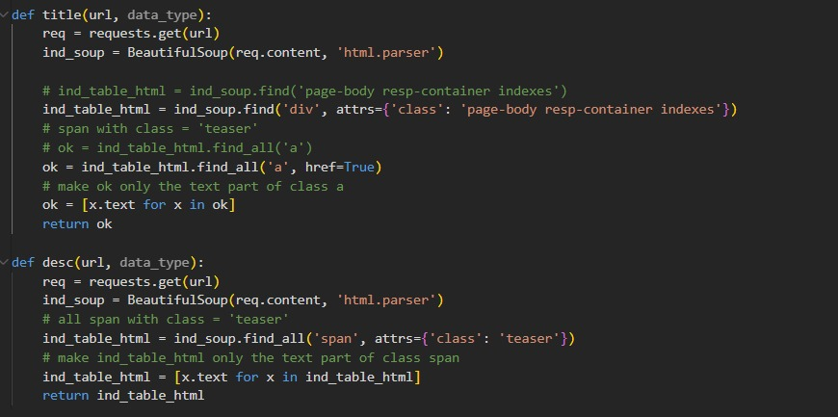

Slide 10
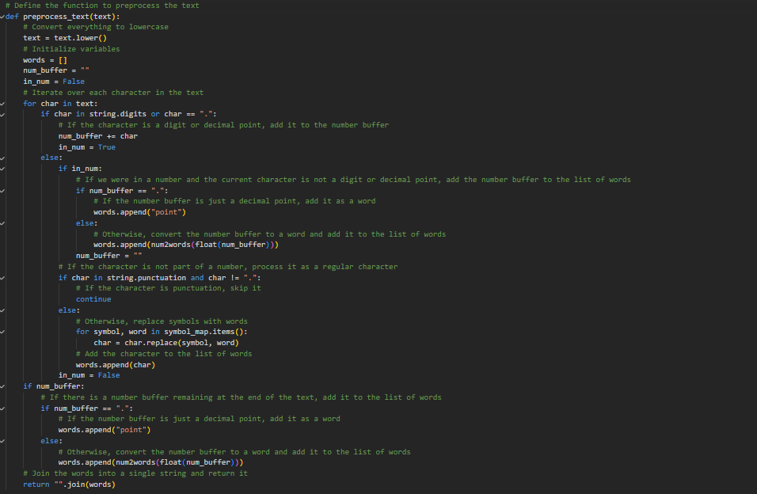

Slide 11
DATA COLLECTION
04

Slide 12
We explored around 16 websites of healthcare data.
We collected around 4000 text files of raw data from various healthcare sites like medscape, medicalxpress, med-gadget.
DATA COLLECTION
The data was then processed for human- speech like text that included following changes:
1. Removing punctuation 2. Formatting symbols to words 3. Converting numbers to figures in words. 4. Taking care of float datatype in the text.

Slide 13
FUTURE WORK
05

Slide 14
Data annotation for integration with Chatbot.
Collect data in 2-3 Indian languages along with English..
FUTURE WORK
Education-domain data
We plan to use ASR to generate text files corresponding to the audio files collected from YouTube videos and then compare the transcript data and the text generated by the test ASR model, to get their similarity and estimate the model’s accuracy.

Slide 15
CHALLENGES & RESULTS
06

Slide 16
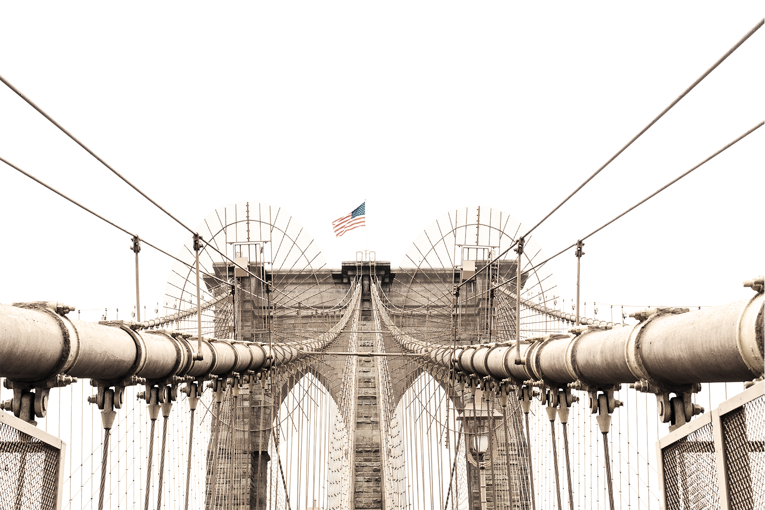
CHALLENGES
LANGUAGE DETECTION
MISSING SENTENCES
DIFFERENT FORMS OF PROUNCIATION

Slide 17

RESULTS
We were able to collect enough quality data related to healthcare domain which can be directly used for further feeding.
Our project has the potential to make a significant impact on the healthcare industry by making it easier to transcribe health-related speech.

Slide 18
Generated text

Slide 19
VAIBHAV AGARWAL
URVISH PUJARA
OUR TEAM

Slide 20

THANK YOU

